Slide 1
RE 2: Subclassification and Matching
UIUC ECON 474 Econometrics of Policy Evaluation

Slide 2
Today
Reading for next class: Ch 5.3 & 5.4
Q: What if randomization is assign based upon values of covariates?
Ex) Tennessee’s Student Teacher Achievement Ratio (STAR) Experiment
Randomly assign kindergarten classrooms to be:
Small classroom
Large classroom
Large classroom with an aide
Assignment is random conditional on each school

Slide 3

Conditional Independence Assumption (CIA)

Slide 4
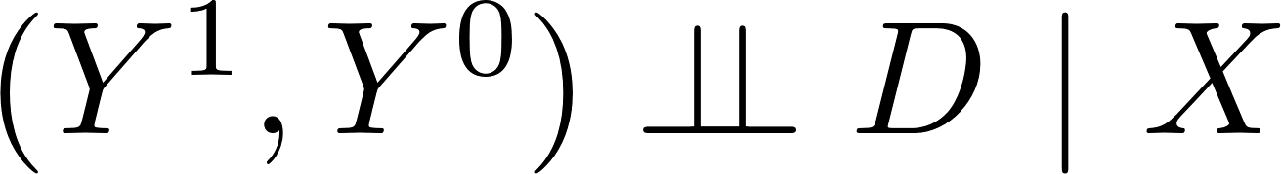
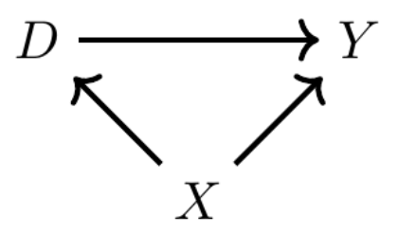
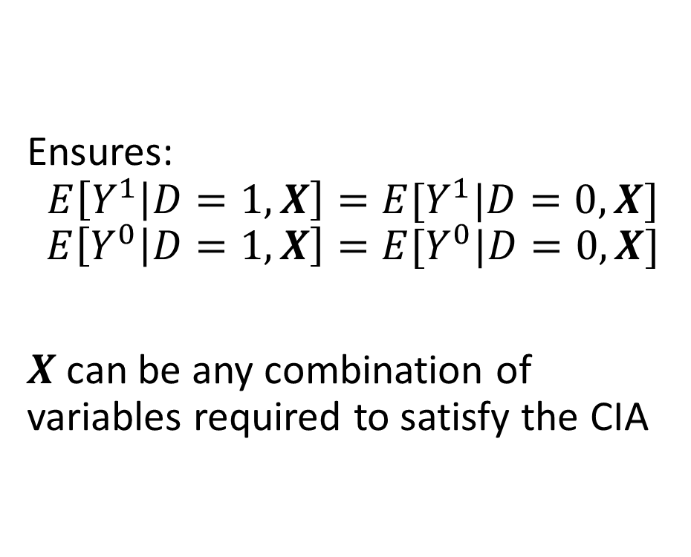
Conditional Independence Assumption (CIA)
Ensures:
$$E\left[Y^{1} | D=1,X\right]=E[Y^{1}|D=0,X]$$
$$E\left[Y^{0} | D=1,X\right]=E[Y^{0}|D=0,X]$$
$X$ can be any combination of variables required to satisfy the CIA

Slide 5
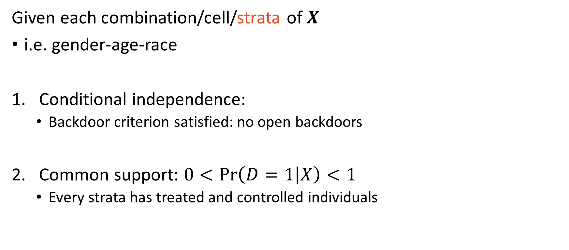
CIA Identifying Assumptions
Given each combination/cell/strata of $X$
i.e. gender-age-race
Conditional independence:
Backdoor criterion satisfied: no open backdoors
Common support: $0<\operatorname{Pr}\left(D=1 | X\right)<1$
Every strata has treated and controlled individuals

Slide 6
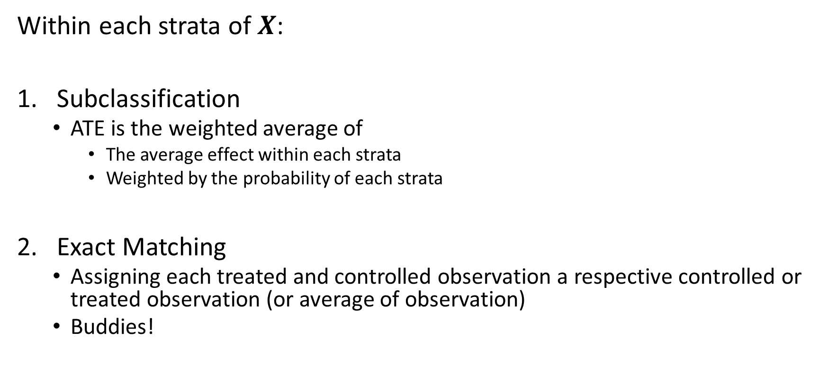
Two Basic Techniques to Satisfy CIA
Within each strata of $X$:
Subclassification
ATE is the weighted average of
The average effect within each strata
Weighted by the probability of each strata
Exact Matching
Assigning each treated and controlled observation a respective controlled or treated observation (or average of observation)
Buddies!

Slide 7
Subclassification
Weighted averages of group averages

Slide 8
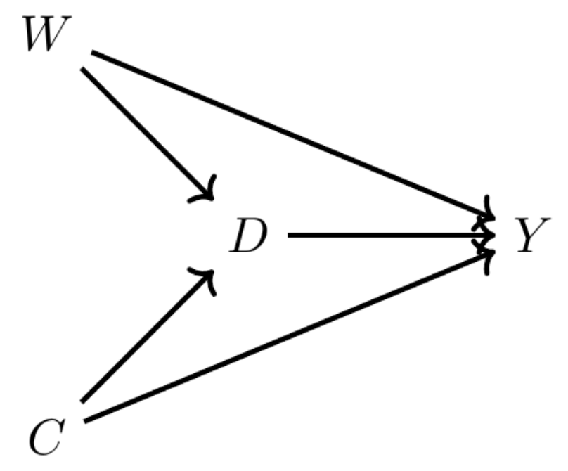
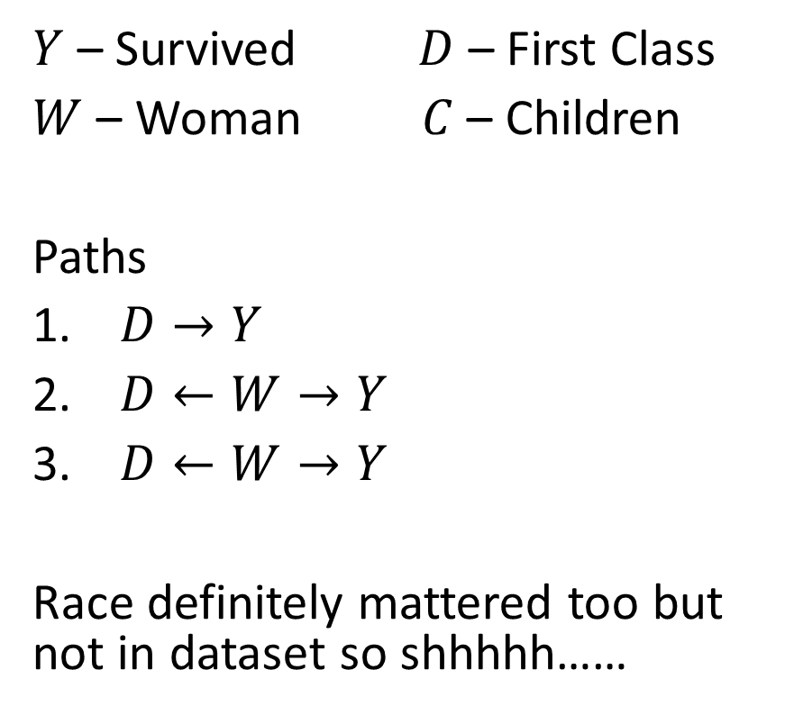
Example: First Class Titanic Passengers and Survival
$Y$ – Survived $D$ – First Class
$W$ – Woman $C$ – Children
Paths
$D→Y$
$D←W→Y$
$D←W→Y$
Race definitely mattered too but not in dataset so shhhhh……

Slide 9
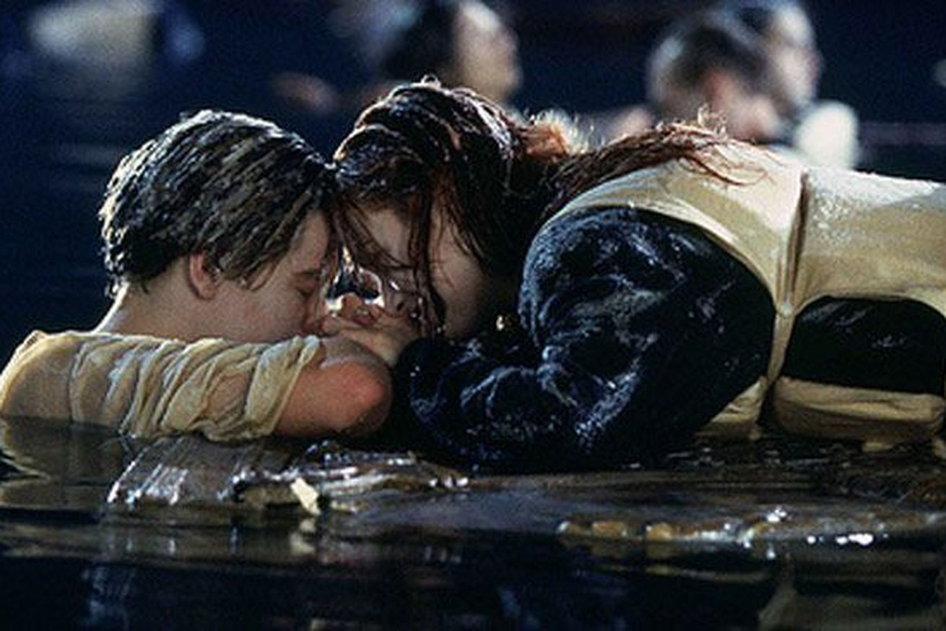
Example: First Class Titanic Passengers and Survival

Slide 10
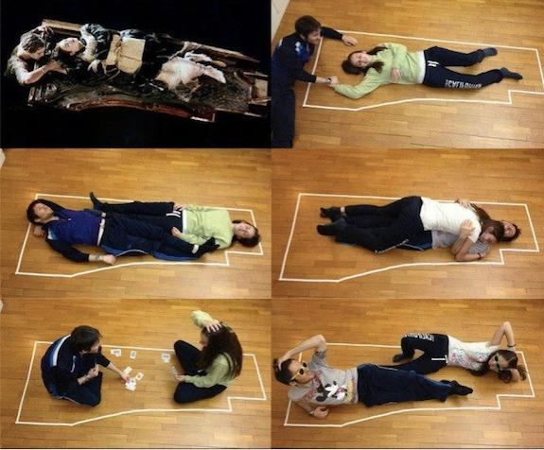
Example: First Class Titanic Passengers and Survival

Slide 11
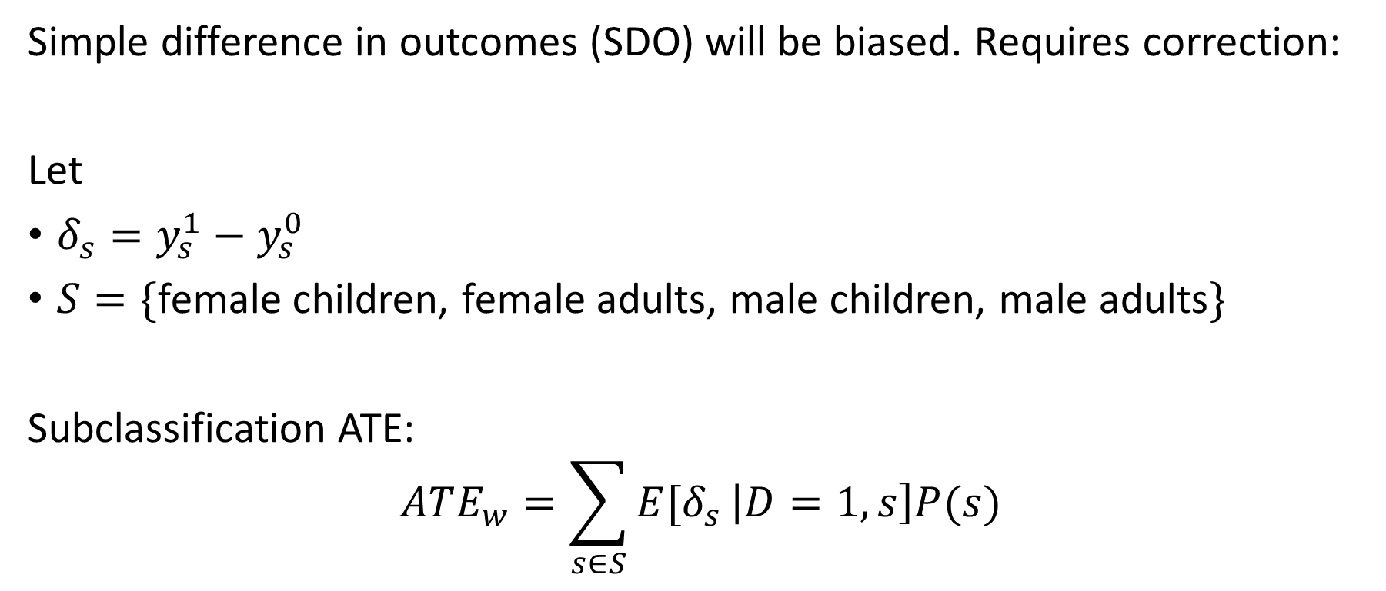
Anyway…. The point being….
Simple difference in outcomes (SDO) will be biased. Requires correction:
Let
$δ_{s}=y_{s}^{1}−y_{s}^{0}$
$S=\{$female children, female adults, male children, male adults$\}$
Subclassification ATE:
$$ATE_{w}=\sum_{s∈S}{E[δ_{s}}\left|D=1,s\right]P(s)$$

Slide 12
Exact Matching
Buddies! Or averages of Buddies! Wait, how do you average a buddy?

Slide 13
What if some strata only have treated observations?
Option: impute missing values conditional on confounding observed variables
Requires some sort of matching technique
Impute with average of untreated observations with confounding variables nearest to the value needing imputation
“nearest neighbor”
Precursor to above:
Exact matching – no imputing

Slide 14
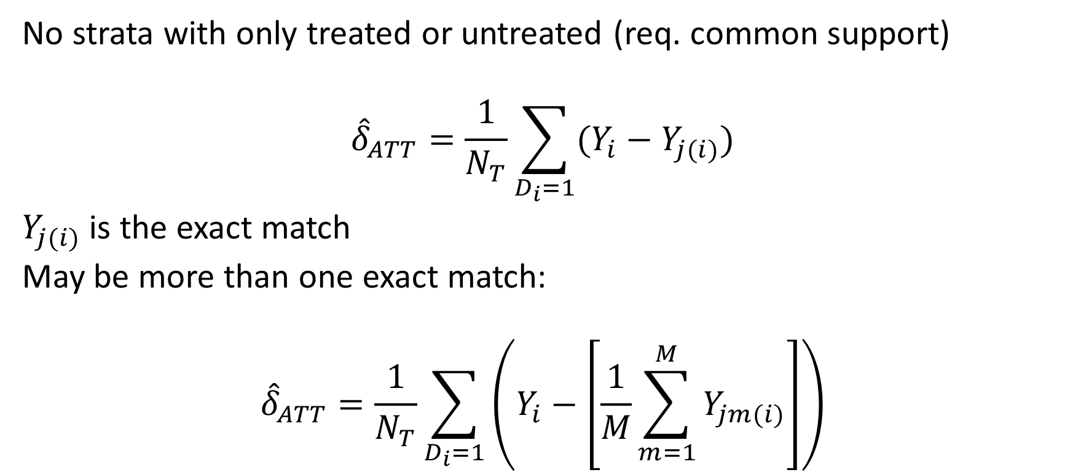
Exact Matching ATT – Buddies for treated
No strata with only treated or untreated (req. common support)
$${\hat{δ}}_{ATT}=\frac{1}{N_{T}}\sum_{D_{i}=1}{(Y_{i}−Y_{j(i)})}$$
$Y_{j(i)}$ is the exact match
May be more than one exact match:
$${\hat{δ}}_{ATT}=\frac{1}{N_{T}}\sum_{D_{i}=1}{\left(Y_{i}−\left[\frac{1}{M}\sum_{m=1}^{M}{Y_{jm(i)}}\right]\right)}$$

Slide 15
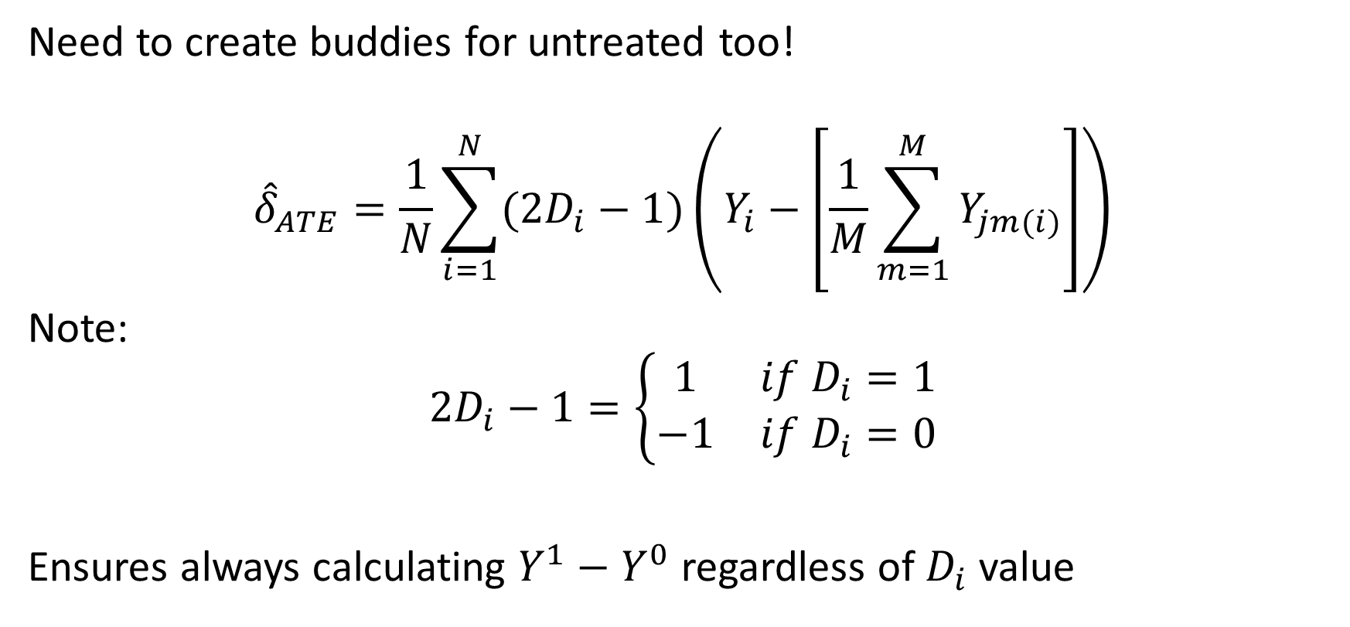
Exact Matching ATE
Need to create buddies for untreated too!
$${\hat{δ}}_{ATE}=\frac{1}{N}\sum_{i=1}^{N}{(2D_{i}−1)\left(Y_{i}−\left[\frac{1}{M}\sum_{m=1}^{M}{Y_{jm(i)}}\right]\right)}$$
Note:
$$2D_{i}−1=\left\{\begin{matrix}1 & if D_{i}=1 \\ −1 & if D_{i}=0\end{matrix}\right.$$
Ensures always calculating $Y^{1}−Y^{0}$ regardless of $D_{i}$ value

